Slide 1

Bioinformatics Algorithms – Part 2
Prof. Beccuti
Explained by Bob the Bot

Slide 2

Data Clustering
Clustering data. What does it mean? With clustering, we mean algorithms that can group together, or cluster, data points with a certain meaning.
Most often, these points are variables with some levels. For example, we might be dealing with the different gene expression levels in different samples.

Slide 3
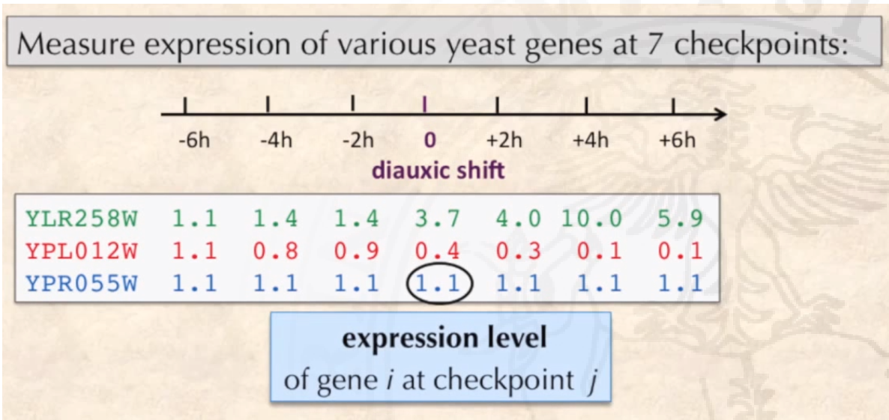

Here, for example, we are seeing the expression of genes at different time points in a yeast sample.
Yeast changes expression of some genes dramatically when switching metabolism. So, we might want to group together genes that increase their expression, genes that do not change, and genes that decrease their expression.

Slide 4
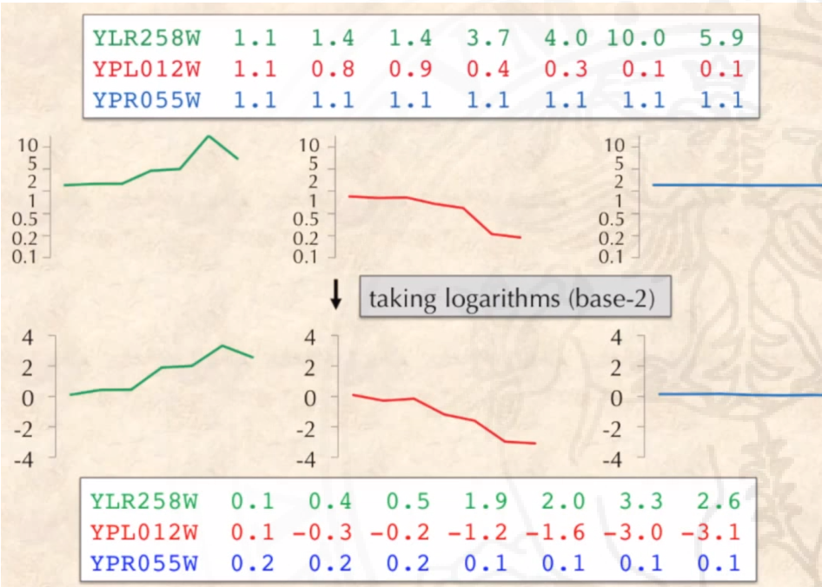

By plotting the data we can clearly see that some genes increase their expression levels, some remain the same and some decrease. By taking the log_2 logarithms of the expression values we can both appreciate the magnitude of decrease (0-1) and increase (>1) of gene expression.

Slide 5

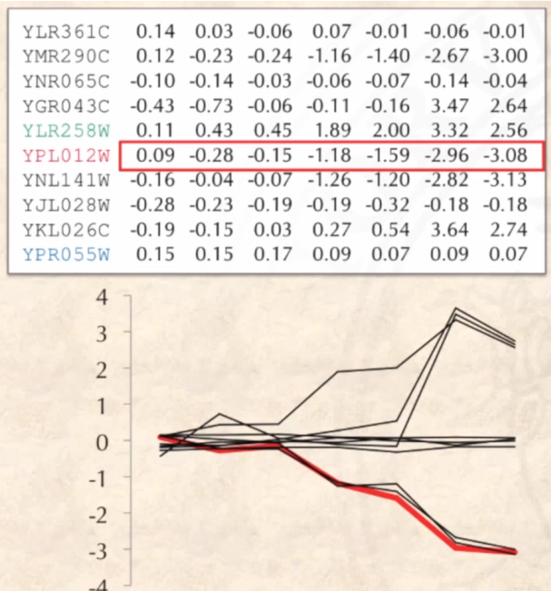
So, we would have a graph like this…

Slide 6
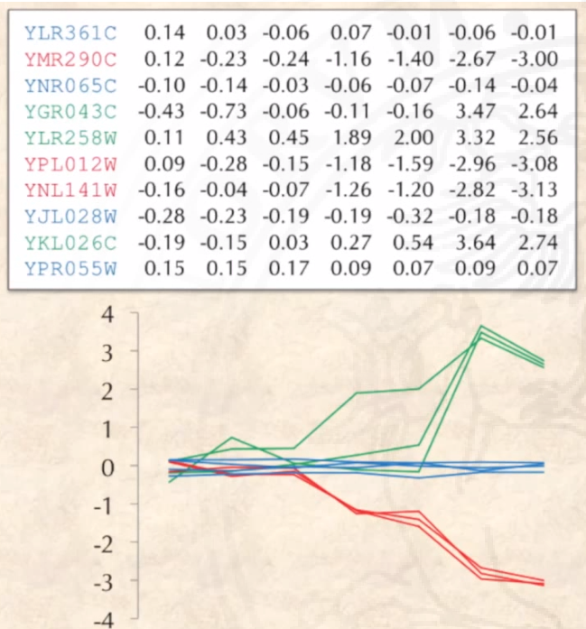
To be labelled as such!

Slide 7
For the record, this is a gene expression matrix.
And this is the data clustered in three clusters (low, mid, high), we can say we have k = 3 clusters.
From now on, we will use “k” as the number of clusters.

Slide 8
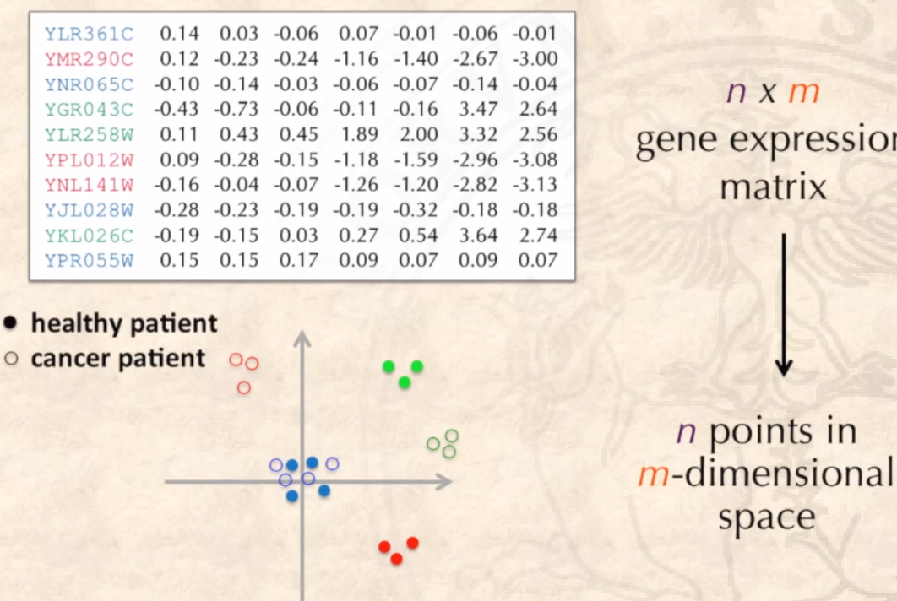
In general, we can move from a n x m gene expression matrix, to a graph with n points in an m-dimensional space. For example, if we have 6 samples tested for 200 genes, we would have 6 points in a 200-dimension graph!
What? Your human brain cannot handle 200-dimension graphs? Well, I’ll show you 2D examples, instead.
Consider that with real data sets we can use PCA or other dimension-reducing methods to first reduce the dimensionality of our data and then run the algorithms for clustering.

Slide 9
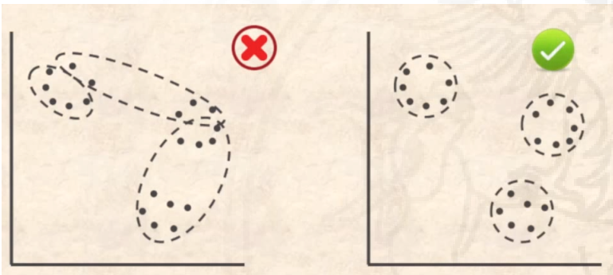
Clustering as an Optimization Problem
We can see clustering as an optimization problem. What does that mean? We need to optimize over the course of the algorithm our clustering, so that, by the end, we have the best possible clusters that we can get from the data.

Slide 10
How do we tackle such a problem? Well, we can first consider that a good cluster contains points that are closer together than points in other clusters.
This is the Good Clustering principle.

Slide 11
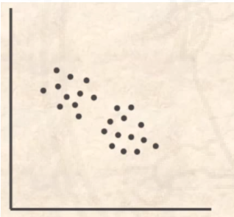
Following the good clustering philosophy, it should be easy to find the two (quite obvious) clusters in this graph.
We begin by saying that points in a cluster should be closer than a certain value Δ, and points in other clusters should be further away.

Slide 12

However, consider this: If we draw a line like such, dividing the points in the two obvious clusters…

Slide 13
However, consider this: If we draw a line like such, dividing the points in the two obvious clusters…
Delta must be, at minimum, this distance here, in blue.

Slide 14
However, consider this: If we draw a line like such, dividing the points in the two obvious clusters…
Delta must be, at minimum, this distance here, in blue.
So, these points here would fall in the same cluster!
It turns out that, in real-life situations, the good clustering principle can never be followed.

Slide 15
We have seen that we cannot use the good clustering principle in real data sets. So, what can we do? Let’s formulate the problem formally.
Clustering problem
Find k clusters of points in a dataset.
Input: A set of datapoints, k
Output: The same datapoints, divided into k meaningful clusters
This problem is vague. What do we define as “meaningful”?
We need to define some sort of parameter, which we can calculate from the data points, to take into account to solve the problem.

Slide 16
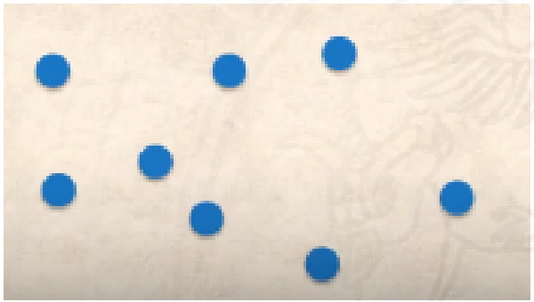
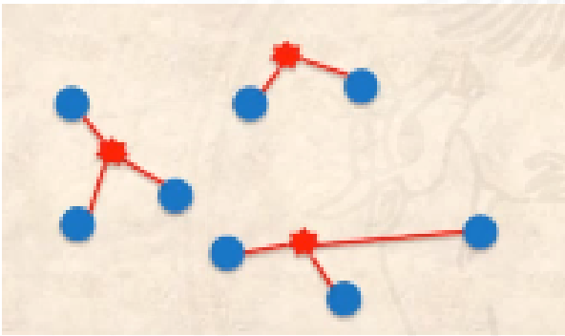
We can consider k centres, and as a parameter, the distance of the points between the centres and the points.
We could then define as clusters the groups of points which minimize the distance between the centres and the points in the cluster themselves.
So, an equivalent problem of the one we had before would be:
Clustering problem, redefined
Find k clusters of points in a dataset.
Input: A set of datapoints, k
Output: Find a set of k points “Centres” that will be the “centres” of the k clusters in Data, and will minimize some notion of distance from Data to Centres.

Slide 17
Now we just need to define the notion of distance. Remember that we are talking of a computer program!
We will say that the distance of a point to the data set Centres is the minimum distance of the point to any of the Centres.

Slide 18
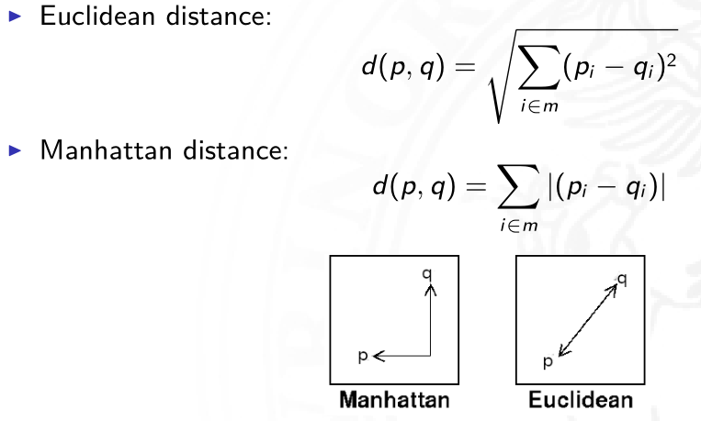
How do we measure distance? We have several ways to do this. The most obvious is Euclidian distance, the direct distance between the points. We could also use Manhattan distance, which doesn’t allow moving diagonally.
Which do we choose? In general, it is a matter of preference. However, since Manhattan distance is slightly easier to compute, we might want to sue it for very large Data sets.

Slide 19
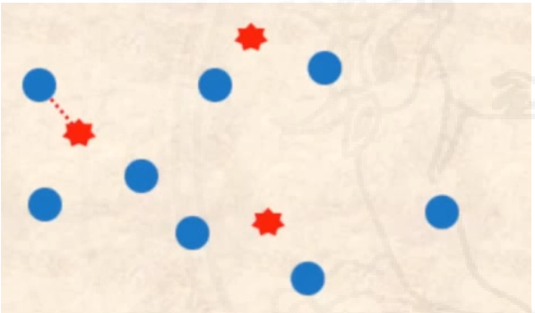
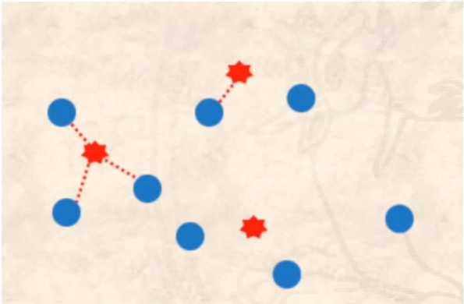
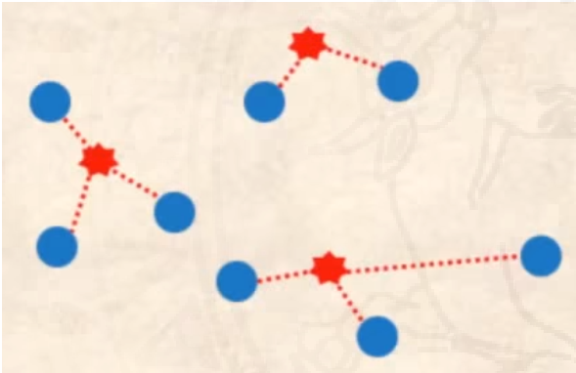
Let’s say we know the centre points in advance. How would we calculate which point goes into which cluster?
We simply compute the distance between each point and the centres set, and assign the point to the centre with the smallest distance.

Slide 20
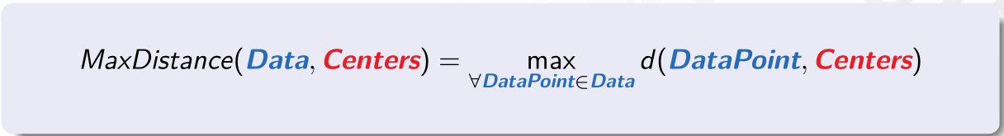
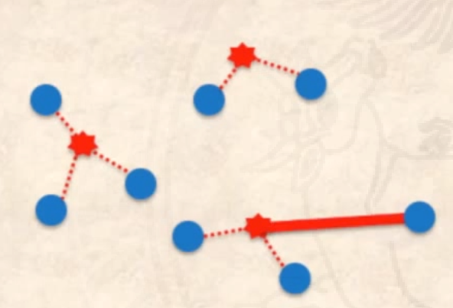
We can also define the Max Distance between the data points and the centres to be the maximum distance between a point and its corresponding centre.
We’ll use this information later.
In this example, MaxDistance is the one highlighted here.

Slide 21
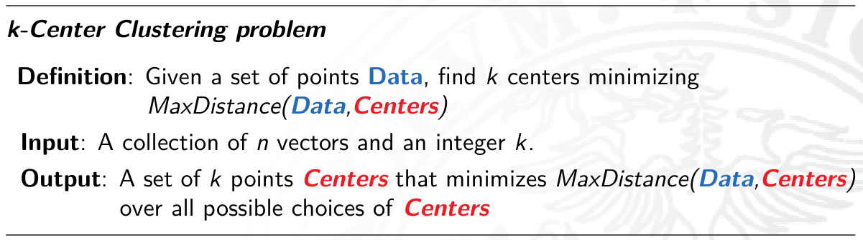
Using this notion of maxDistance, we can tweak our problem:

Slide 22
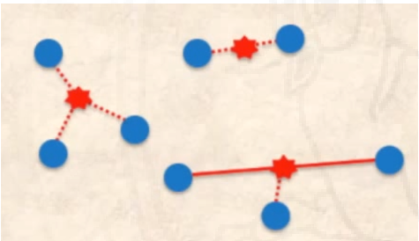
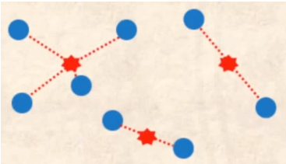
Using this notion of maxDistance, we can tweak our problem:
Here, I’ve found a better set of centres for our problem using this definition!

Slide 23
However, to find the BEST possible set of centres we would have to test every possible set of centres. Remember how brute-force algorithms almost never work? Exactly.
Algorithms that solve this problem use Heuristics, approximation methods, in order to limit the time spent computing but still arriving at a somewhat-optimal (but always sub-optimal) solution.

Slide 24
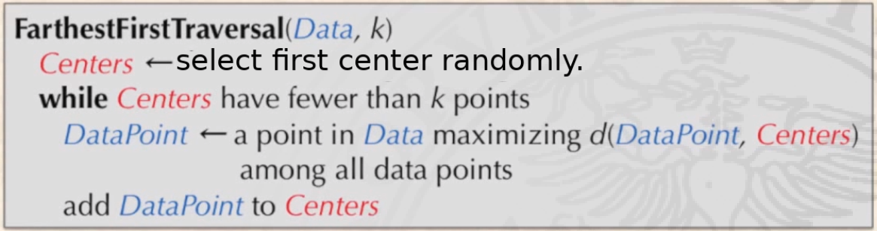
One of the first algorithms we will look at can heuristically find one solution for the K-centres problem.
It first sets the first centre by randomly selecting a point in the data. It then finds the data point furthest from the centre and sets that at the second centre. It then repeats, setting more centres as the datapoints that maximise the distance between the data and the centres.

Slide 25
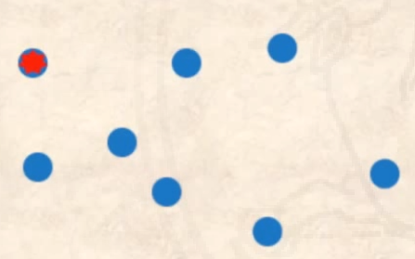
We select the first point randomly.

Slide 26
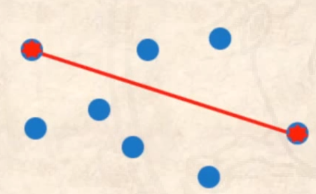
We select the next centre as the point maximising the distance data-centres

Slide 27
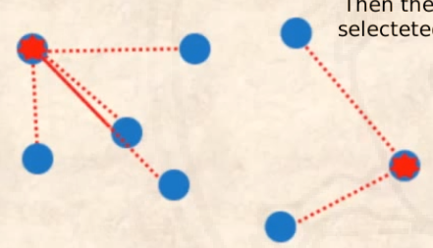
We then assign the points to the centres, and repeat the computation, selecting the next centre as the point the maximises the distance data-centres.
We stop when we select k centers.

Slide 28

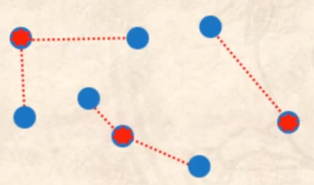
This run has given us these three points as centres. Not bad!
Keep in mind the big limitation of the centres having to lie in existing points.
Consider also that, since the first point is selected randomly, the algorithm will give a different output every run.

Slide 29

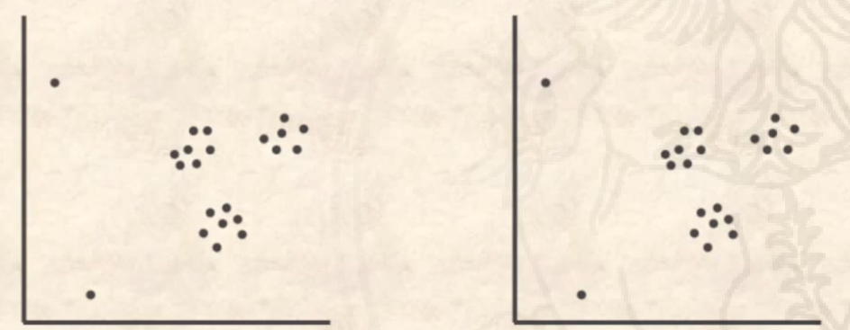
However, we can run into some problems. How would you divide this set of data? We see three clusters, but look at what FarthestFirstTraversal gives us as an answer for k = 3…

Slide 30
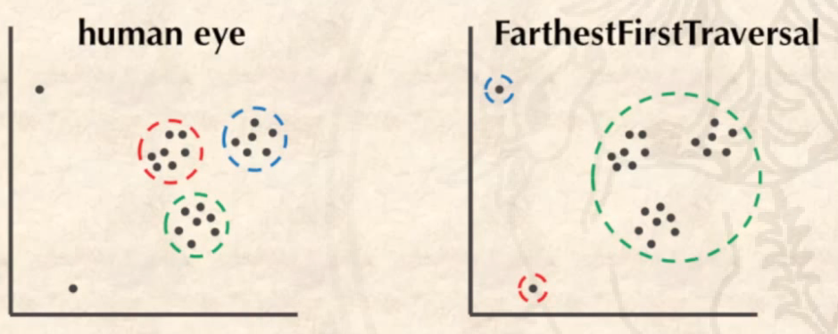
This won’t do! FarthestFirstTraversal is very sensible for outliers. We need to define a new parameter to work with instead of MaxDistance, as to be less sensible to these far points.

Slide 31
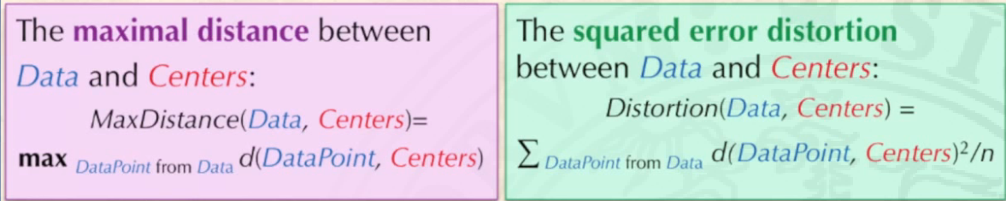
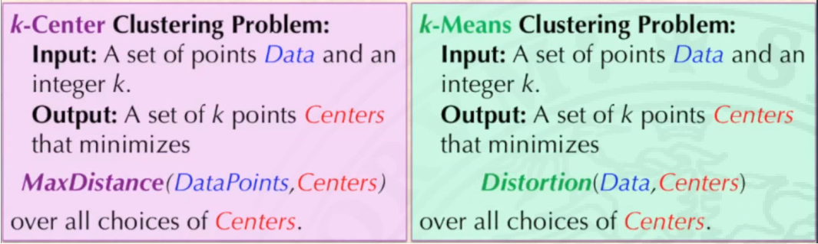
To solve this problem, we can move from finding the max distance to something less drastic, such as the average squared distance of the points and the data. This is the bases for the k-means algorithm.

Slide 32
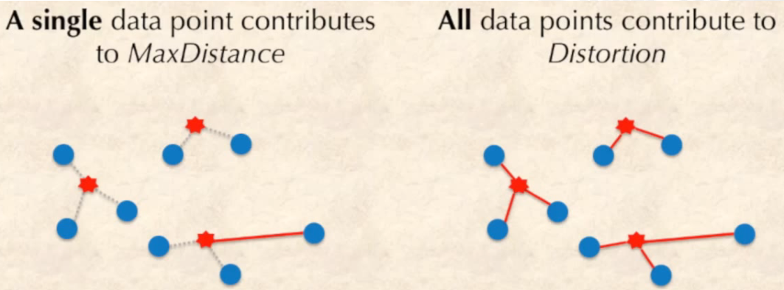
K-clusters considers a single point in order to set the new centre, while k-means considers all points in order to find a new centre.

Slide 33
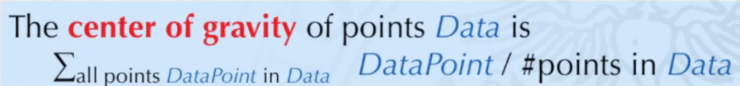
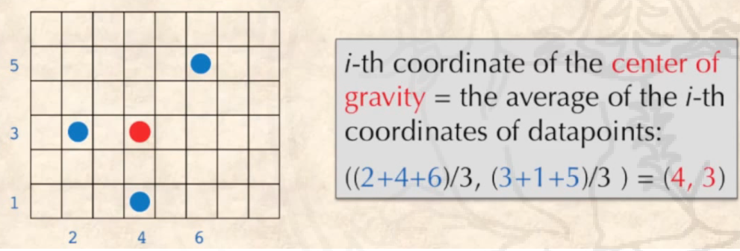
K-means also allows us to exit the dataset in order to find a centre. It uses the concept of centre of gravity, defined as such.

Slide 34
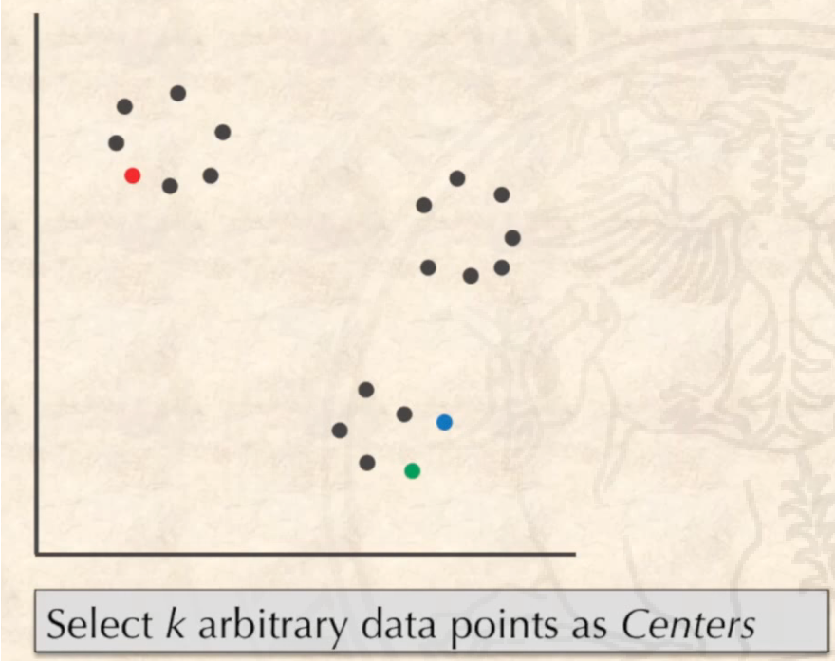

K-means goes like this. We select randomly the first k-points.

Slide 35
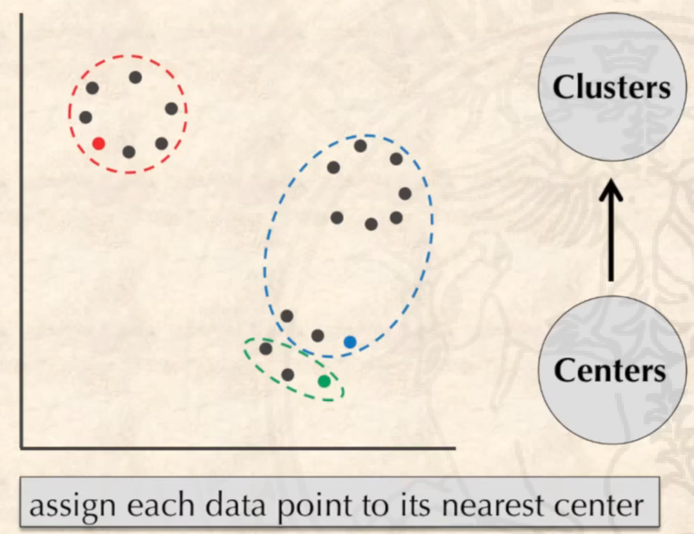
We then assign points to the nearest centre, like we did before.

Slide 36
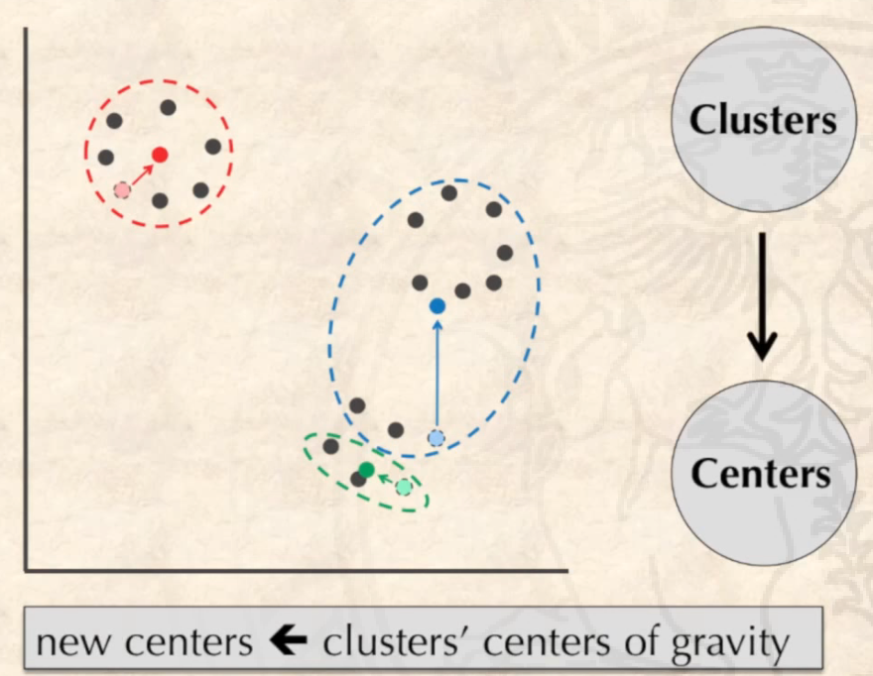
However, we then find the centre of gravity of the points, moving our centres there.

Slide 37
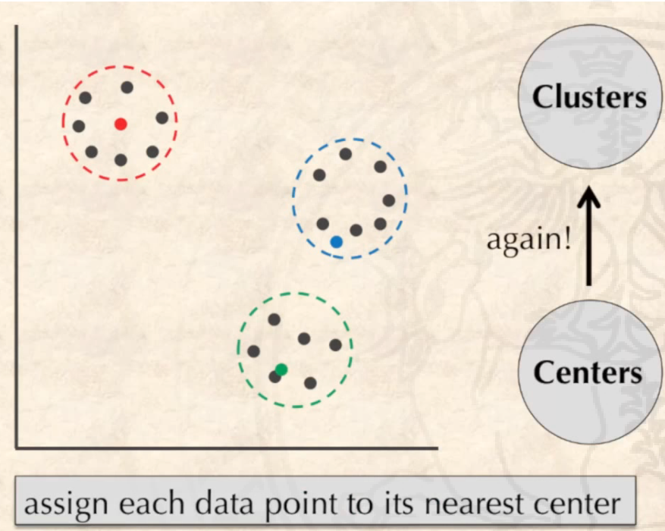
We then re-assign the points to the nearest centres, and repeat!

Slide 38
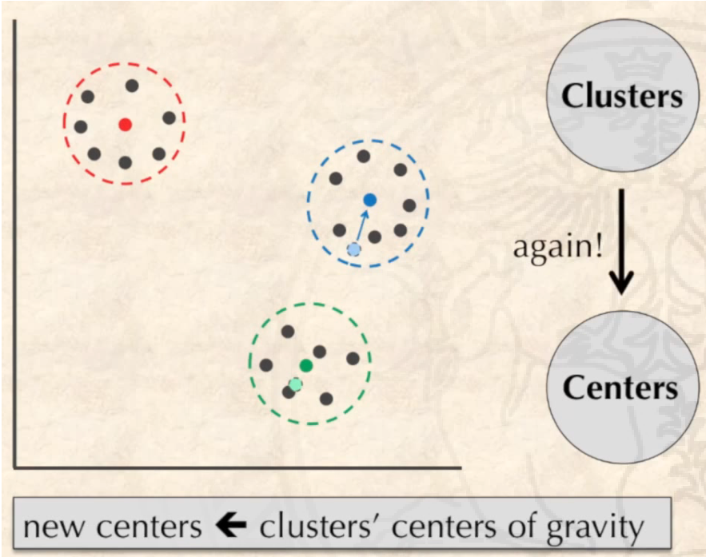
Points to centres…

Slide 39
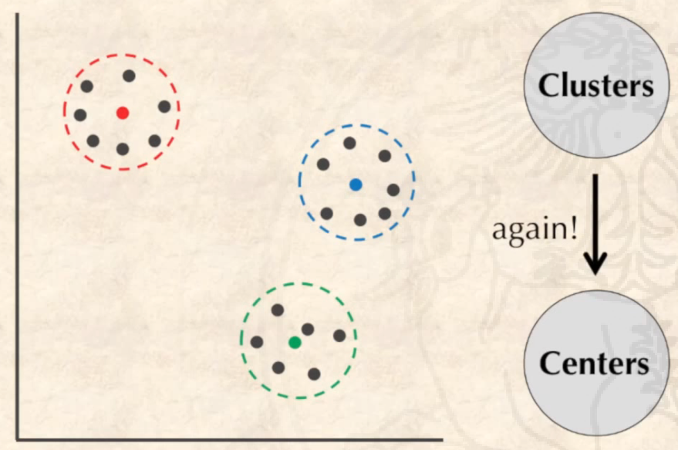
Centres to points!
This algorithm converges quickly to a local minimum distance. It will stop when the centre points do not move between iterations.

Slide 40
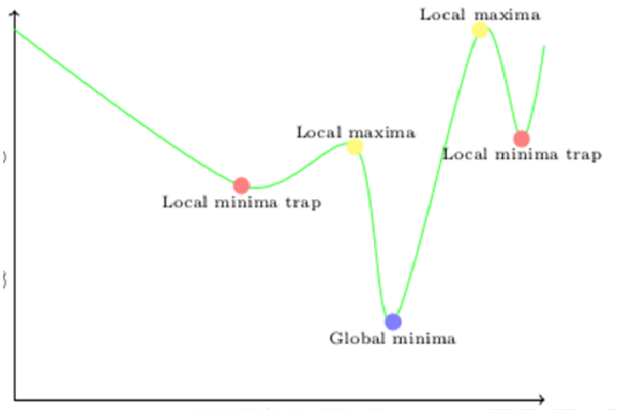
What do we mean with local minimum? Since we set the initial points randomly, and since we always reduce distances using this algorithm, we can fall (converge) into “local minimum” traps, while the actual best clusters are somewhere else.

Slide 41

However, we can simply re-run the algorithm many times and keep the one with the best result!

Slide 42
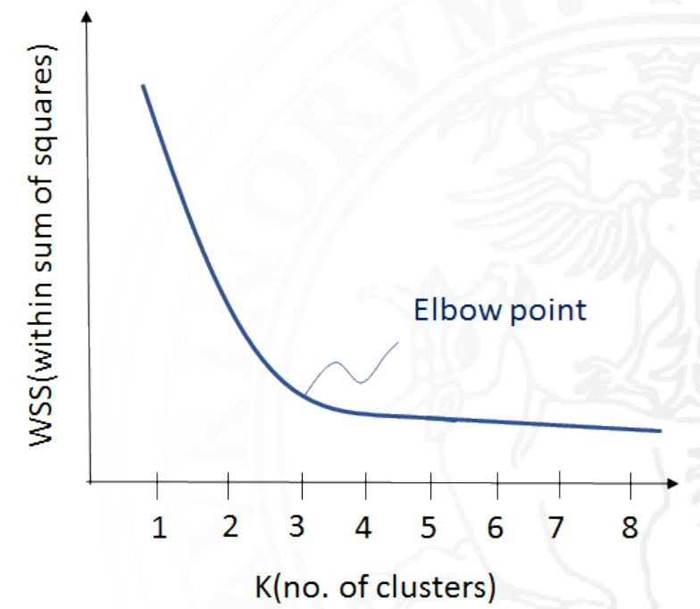
A very big problem of these algorithms is the choice of K. Should it be 1, 2, 5? We cannot know a priori the best k, but we need to give it to the algorithm nonetheless.
However, several mathematical algorithms have been developed to approximate, based on the data, the best k. For example, the “elbow method” shown here.

Slide 43
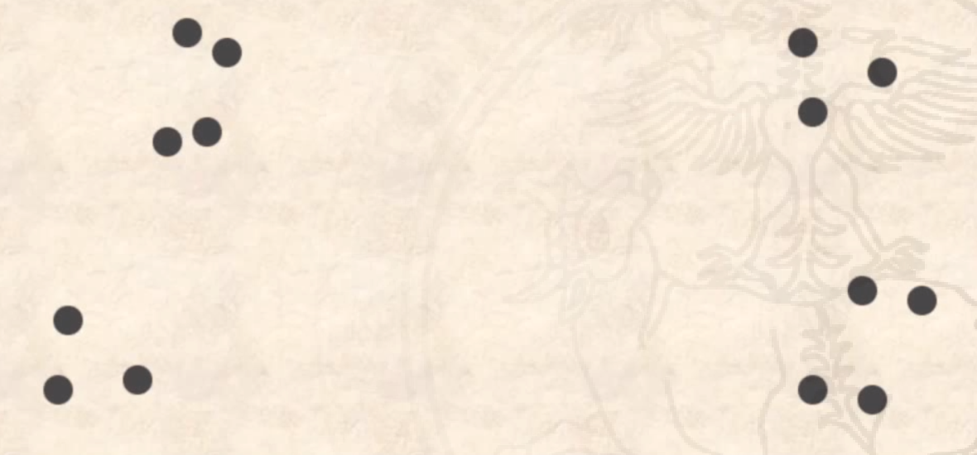
Hierarchical clustering
Consider these points. Can you see any clusters?

Slide 44
Let’s draw two major clusters, here in red.

Slide 45
We can further subdivide these clusters into sub-clusters, here in orange.

Slide 46
And further on…

Slide 47
Until we reach the point themselves, each of them being a cluster of only a single dot. Can we use this, let’s say, property to reverse-engineer the larger clusters?

Slide 48
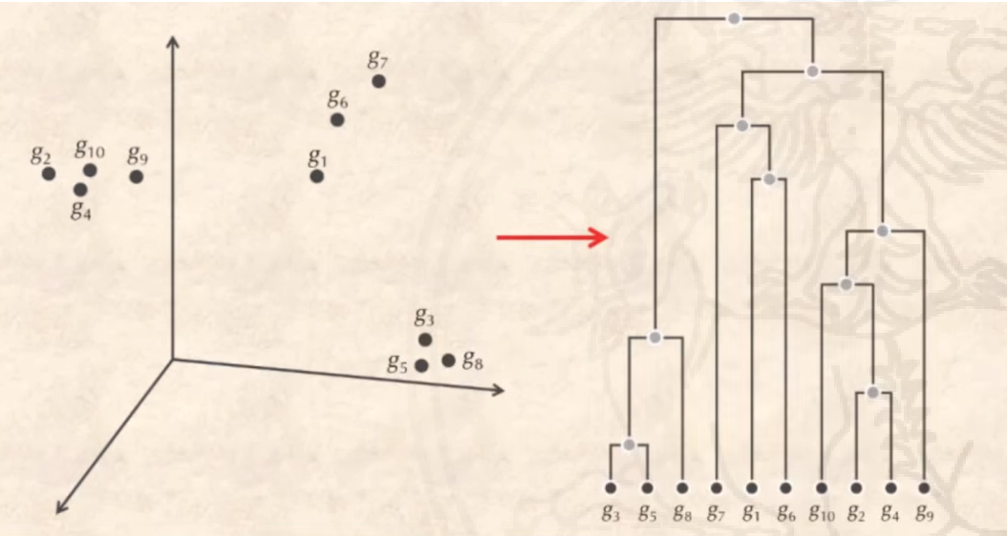
Turns out, we can! This method is called Hierarchical clustering, and is one of the most used, at least for smaller datasets.
We will create a hierarchy graph like this one from the points’ coordinates.

Slide 49
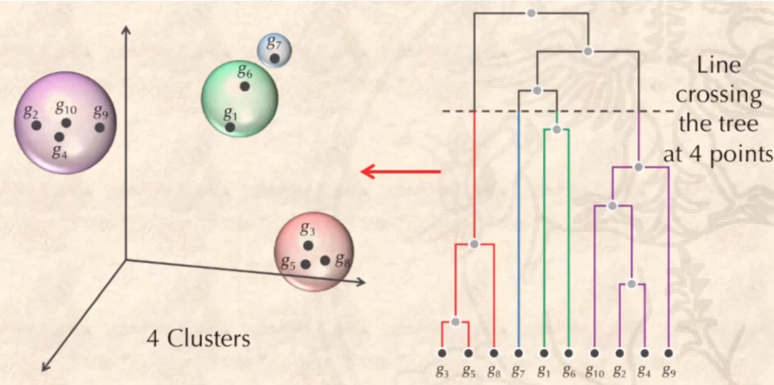
If we want a specific number of clusters k, we can simply “cut” our hierarchy diagram in a specific place! This eliminates the need of having to select a k a priori.

Slide 50
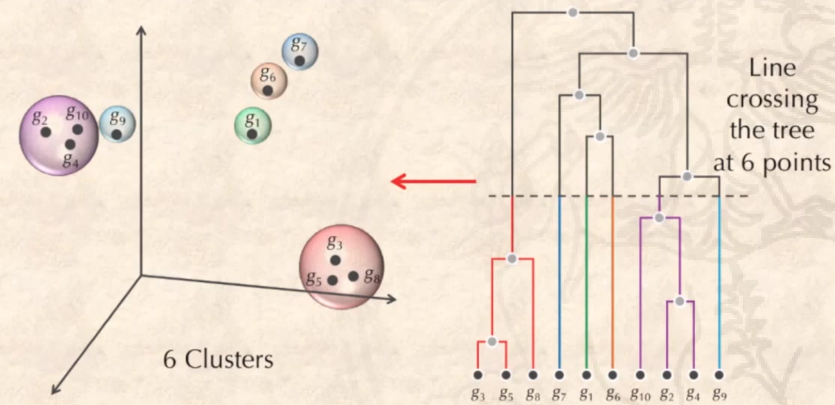
This diagram is also called a tree. The largest cluster (at the top) is the root, and the single points are the leaves. It is a kind of graph!

Slide 51
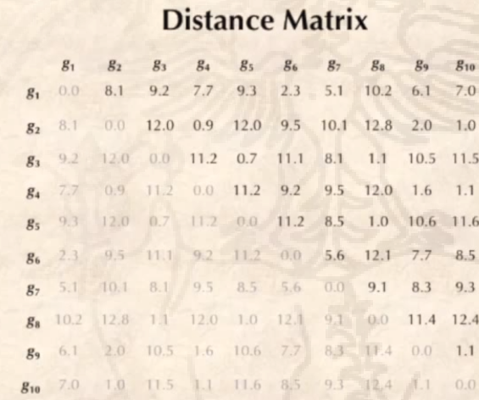
How can we compute such a hierarchy? We first compute the distances between all sets of points. We then pick the pair of points with the smallest distance, and set them as a cluster. We then recalculate the distances in the distance matrix by eliminating the two selected points, and adding the new cluster. The distance point-cluster can be both the minimum distance of each point in cluster/point pair, or the average.
We then repeat until the whole table is removed, and we have a single, large cluster (root)

Slide 52
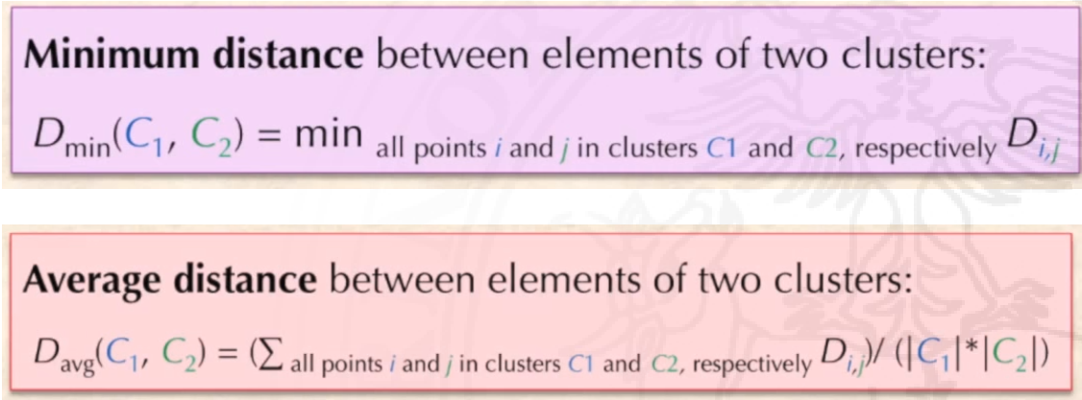
As I said before, this is some examples on how to compute the distance between a cluster and a point, or between two clusters.

Slide 53
Clustering problem
Find k clusters of points in a dataset.
Input: A set of datapoints, k
Output: The same datapoints, divided into k meaningful clusters
SOLVED

Slide 54
